Slide 1

The Gospels
An Overview of the Four Gospels in the New Testament
Presented By:
INEZA Ange Pamella
TUYISENGE Esperance
MUTANGANA Joseph
NKURANGA Baziga Caleb
UWAYEZU Samuel

Slide 2

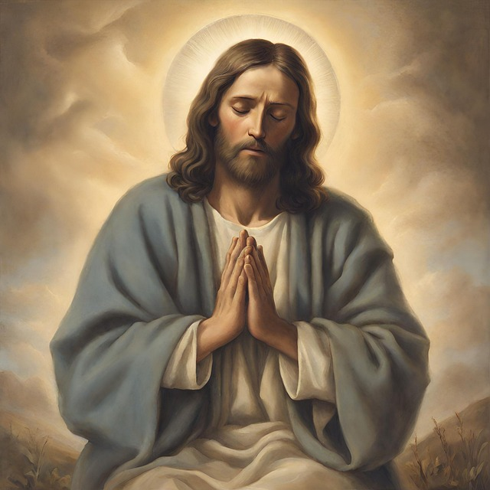
Introduction to the Gospels
What are the Gospels?
The first four books of the New Testament: 1. Matthew
2. Mark
3. Luke
4. John
They describe the life, teachings, death, and resurrection of Jesus Christ.
The Gospels are considered the foundation of Christian belief and practice.

Slide 3
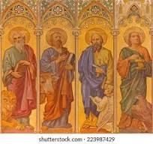
Overview of the Four Gospels
Matthew: Written for a Jewish audience, highlights Jesus as the fulfillment of Old Testament prophecies.
Mark: The shortest Gospel, emphasizes the suffering of Jesus and portrays him as the Son of God.
Luke: Focuses on the compassion of Jesus, especially toward marginalized groups like women, the poor, and sinners.
John: Theologically deep, emphasizes the divinity of Jesus, and the idea of Jesus as the Word made flesh.

Slide 4
The Gospel of Matthew

Slide 5

Introduction to Matthew
Audience: Primarily Jewish Christians.
Date: Around 80-90 AD.
Purpose: To present Jesus as the fulfillment of Old Testament prophecies and the Messiah.

Slide 6
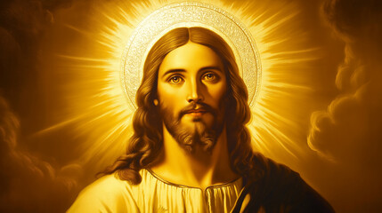
Key Themes in Matthew
1. Jesus as the Messiah: Fulfills Jewish prophecies.
2. Kingdom of Heaven: Both present and future reality, characterized by righteousness.
3. Jesus as the New Moses: New teacher and lawgiver.
4. Discipleship: Emphasis on following Jesus with commitment.

Slide 7
Structure of Matthew
Genealogy and Birth (Ch. 1-2): These chapters (1 and 2) tell the story of Jesus' family background and birth. It shows that Jesus came from a royal line, fulfilling promises made in the Old Testament.
Sermon on the Mount (Ch. 5-7): In chapters 5 to 7, Jesus gives a famous speech with teachings about how to live a good life. It includes the Beatitudes, which are blessings for people who are humble, kind, and peaceful.
Miracles and Parables (Ch. 8-13): In chapters 8 to 13, Jesus performs many miracles, like healing the sick, and shares stories (parables) to teach people important lessons about life and faith.
Passion and Resurrection (Ch. 26-28): Chapters 26 to 28 describe the final events of Jesus' life, including his death on the cross (crucifixion), his rising from the dead (resurrection), and his command to his followers to spread his message (Great Commission).

Slide 8
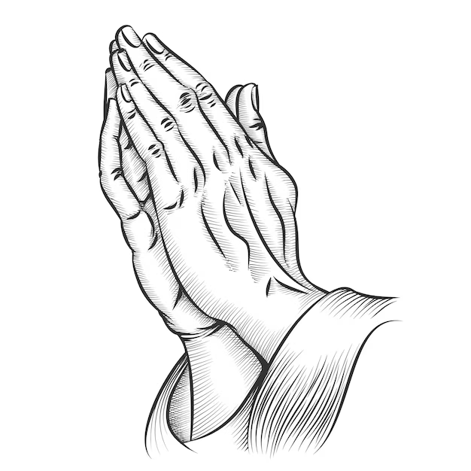
Key Teachings
1. Jesus as the Messiah: Matthew highlights Jesus' fulfillment of prophecy.
2. Ethical Living: The Beatitudes and loving enemies.
3. Judgment and Righteousness: The importance of righteous actions (e.g., Parable of the Sheep and Goats).
4. The Role of the Church: Emphasizes the Church’s mission and authority.

Slide 9

Unique Features
Fulfillment Citations: Links Jesus’ life to Old Testament prophecies.
Five Discourses: Key speeches outlining teachings of the Kingdom.
Jewish Themes: Focus on Jewish customs and Jesus as the fulfillment of Jewish hopes.

Slide 10
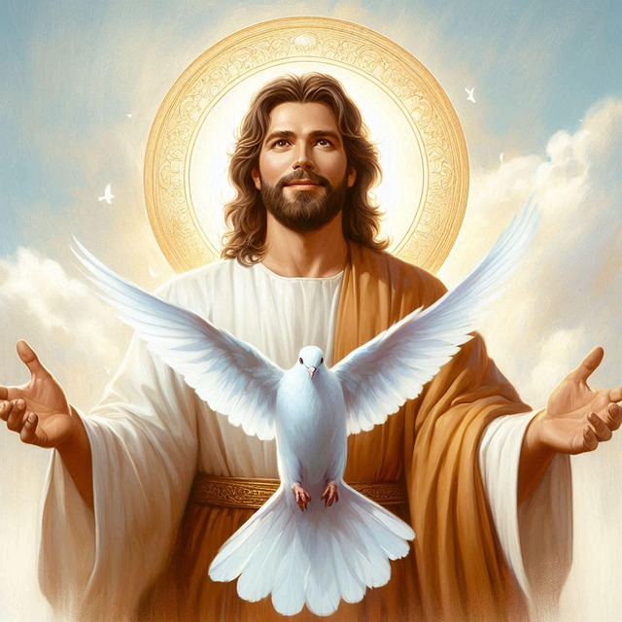
Conclusion
Significance: Presents Jesus as the Messiah, teaches Kingdom ethics, and emphasizes discipleship and the role of the Church.
Key Message: Jesus came to fulfill God's promises and bring God’s Kingdom on Earth.
---

Slide 11
The Gospel of Mark

Slide 12
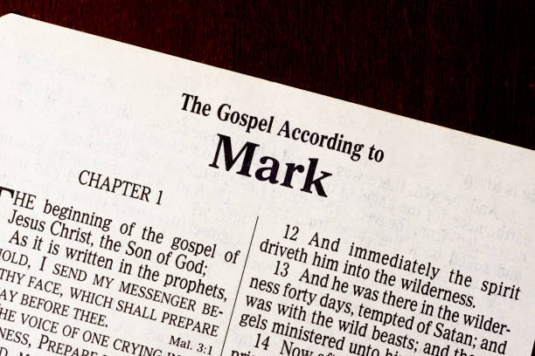
Introduction to the Book of Mark
Written by: Mark (John Mark)
Audience: Early Christians, especially those in Rome
Key Focus: Jesus' actions and miracles more than his teachings.

Slide 13
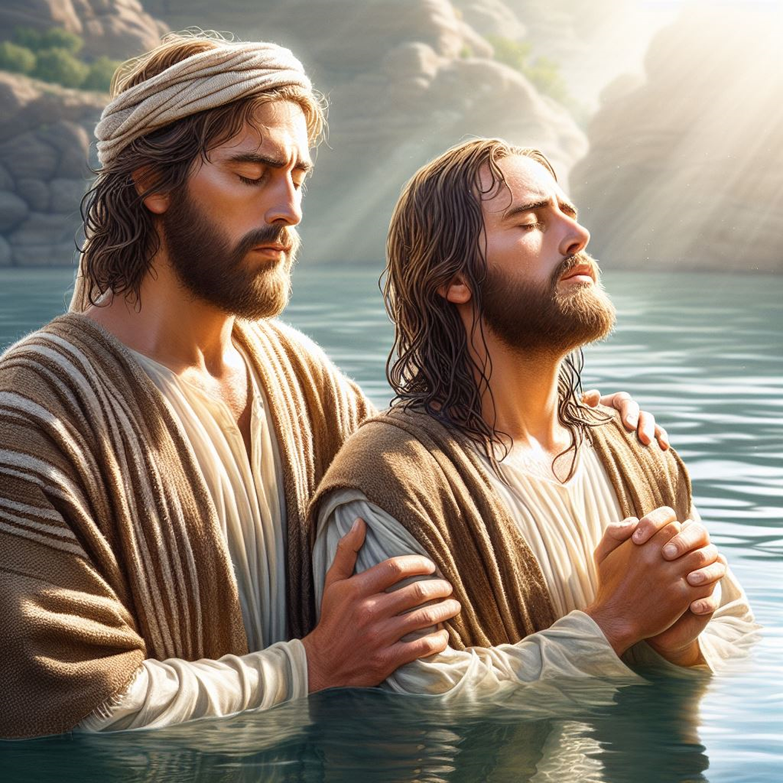
Key Events in the Book of Mark
John the Baptist prepares the way for Jesus.
Jesus is baptized and tempted.
Jesus starts teaching, healing, and performing miracles.
Jesus faces opposition from religious leaders.
Jesus’ death and resurrection.

Slide 14

Themes in the Book of Mark
Jesus is the Son of God.
The Kingdom of God.
Jesus' suffering and sacrifice.
Discipleship: Following Jesus and His example.

Slide 15
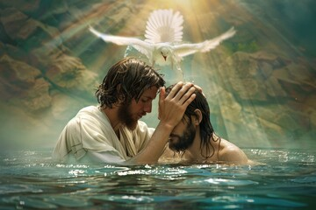
Beginning of Jesus' Ministry
John the Baptist prepares people for Jesus.
Jesus is baptized and starts his work.
Jesus begins to heal and teach.

Slide 16
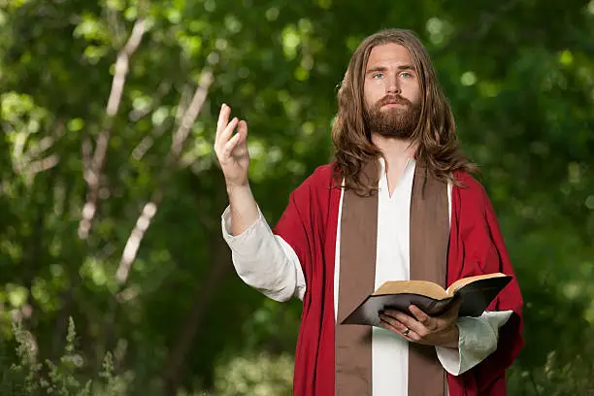
Parables and Teachings
Jesus teaches in stories called parables. (Parables: Short stories, Jesus used to explain about God’s Kingdom.)
Important parables:
1. The Sower(Matayo 13:1-23, Marko 4:1-20, and Luka 8:4-15),
2. The Mustard Seed (Small seed, but grow into large tree. Matthew 13:31-32, Mark 4:30-32 and 13:18-19).
Parables explain deep truths about God’s Kingdom.

Slide 17
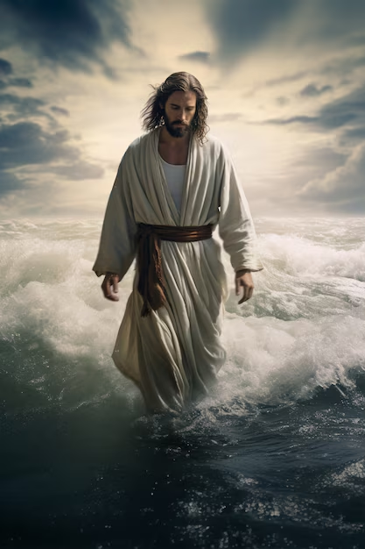
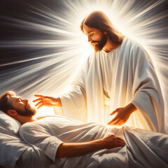
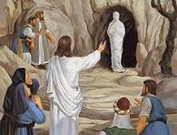
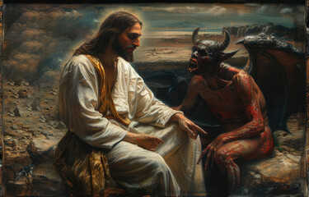
Jesus’ Miracles and Power
Jesus calms a storm.
Heals the sick.
Raises the dead.
Shows his power over nature, demons, and death.

Slide 18
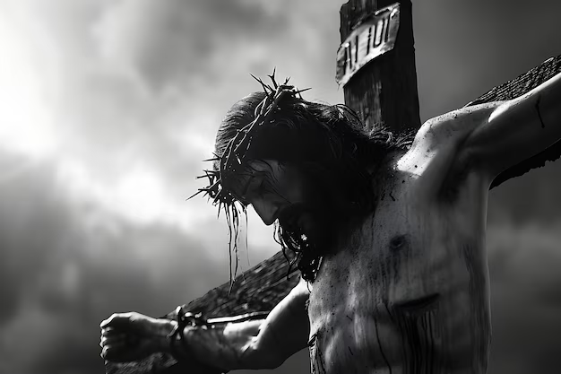
Jesus' Suffering and Death
Jesus is rejected by leaders and people.
He predicts his death.
Jesus is arrested, tried, and crucified.
He dies for the sins of the world.

Slide 19
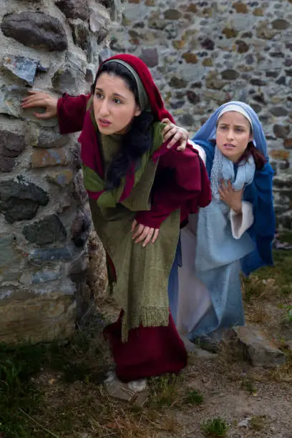
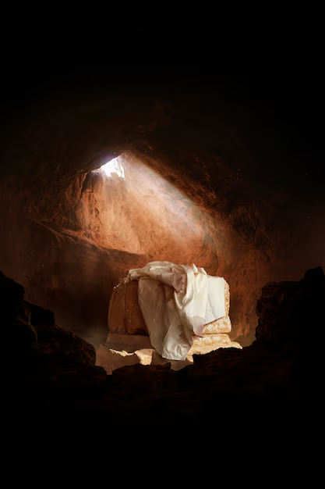
Jesus' Resurrection
The women find the tomb empty.
An angel tells them Jesus is alive.
Jesus' resurrection brings hope to all.

Slide 20

Main Lessons from Mark
Jesus is the Savior and Son of God.
True discipleship, means following Jesus, even when it's hard.
Jesus' power shows that God's Kingdom is real.

Slide 21
Conclusion
Mark’s Gospel is all about the power, love, and sacrifice of Jesus.
It teaches us about faith, following Jesus, and the Kingdom of God.
Jesus is our example and Savior.

Slide 22
The Gospel of Luke

Slide 23
Introduction to Luke
Audience: Gentile Christians (written to Theophilus).
Date: Around 80-90 AD.
Purpose: To present Jesus as the compassionate Savior for all people, especially the marginalized.

Slide 24
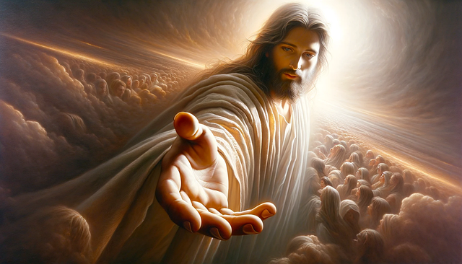
Key Themes in Luke
Jesus cares for the poor, sinners, and outcasts.
Examples: Parables of the lost sheep and the prodigal son.
Salvation is available for everyone, not just the Jewish people.
The Holy Spirit plays a central role in Jesus' ministry.
It highlights the power of the Spirit in the lives of believers.
Jesus is always in communion with God the Father.
Emphasis on the importance of prayer and worship.

Slide 25
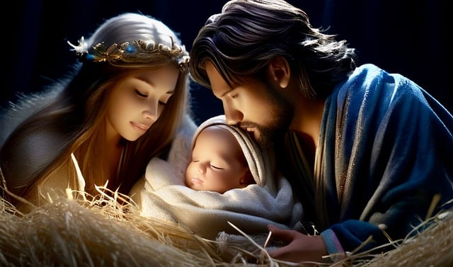
Structure of Luke
Birth and Early Life (Ch. 1-2): Detailed account of Jesus’ birth, including the Annunciation and the visit of the shepherds.
Jesus’ Ministry (Ch. 3-9): Jesus' teachings, miracles, and calling of disciples.
Journey to Jerusalem (Ch. 9-19): The long journey where Jesus teaches about love, mercy, and the Kingdom.
Passion and Resurrection (Ch. 22-24): The Last Supper, crucifixion, and resurrection.

Slide 26

Key Teachings
Inclusiveness: Jesus reaches out to the marginalized (e.g., women, sinners, and Gentiles).
Parables of Mercy: Stories like the Good Samaritan and the Prodigal Son.
The Role of Prayer: Jesus teaches on persistent prayer and the importance of connecting with God.

Slide 27
Unique Features
Detailed Birth Narrative: Unique to Luke, with stories like the angelic announcement to Mary and the visit of the shepherds.
Focus on Women: More mentions of women in the story, such as Mary, Elizabeth, and the widow of Zarephath.
The Ascension: Only Luke includes the Ascension of Jesus (Luke 24:50-53).

Slide 28
Conclusion
Significance: Presents Jesus as a Savior for all people, emphasizing compassion, prayer, and salvation.
Key Message: Jesus' mission is inclusive, offering forgiveness, healing, and eternal life to everyone, especially the marginalized.

Slide 29
The Gospel of John

Slide 30
Introduction
The Gospel of John is unique compared to the Synoptic Gospels (Matthew, Mark, and Luke) because it emphasizes the divinity of Jesus and contains profound theological insights.

Slide 31
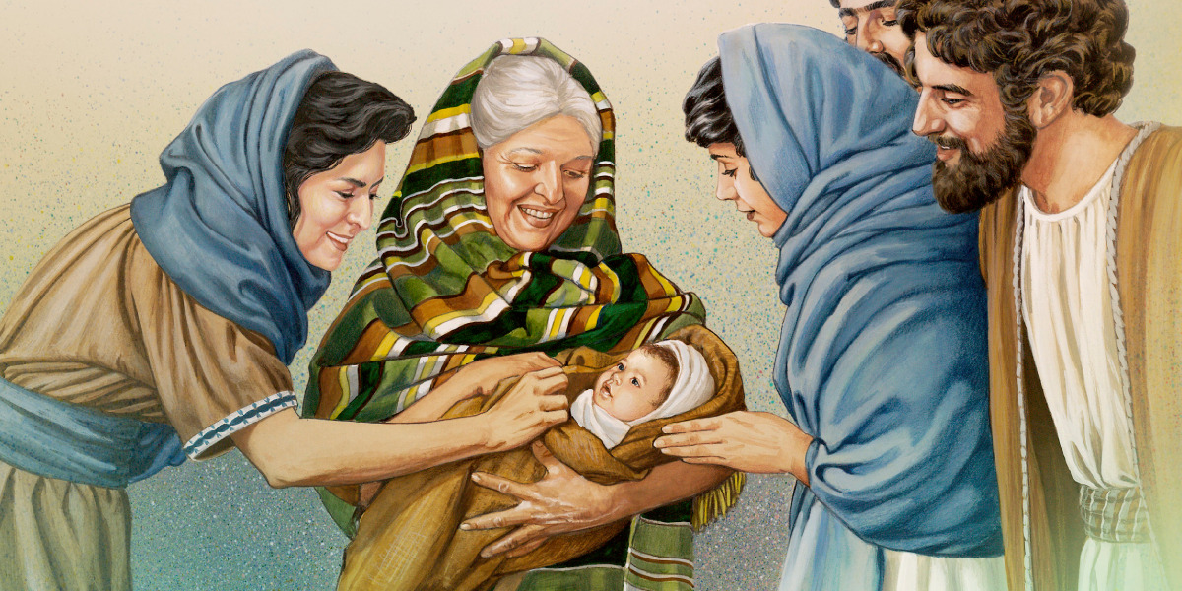
The story of john begins with his parents, Zechariah and Elizabeth, who were both righteous but unable to have children because Elizabeth was barren and they were old.
Notes:
Before we get start about book of john we re going to see in briefy who wos John the parent of jhn were both old but bcs de miracle they got chirld

Slide 32

AUTHORSHIP
1.Traditionally attributed to John the Apostle, one of Jesus’ closest disciples.
2.John, also called “the disciple whom Jesus loved,” was an eyewitness to Jesus' ministry, crucifixion, and resurrection.
3.The writing style and deep theological focus suggest it was written to strengthen believers and offer a spiritual perspective on Jesus' life.
3.Likely written between AD 80-90, addressing both Jewish and Gentile audiences.

Slide 33
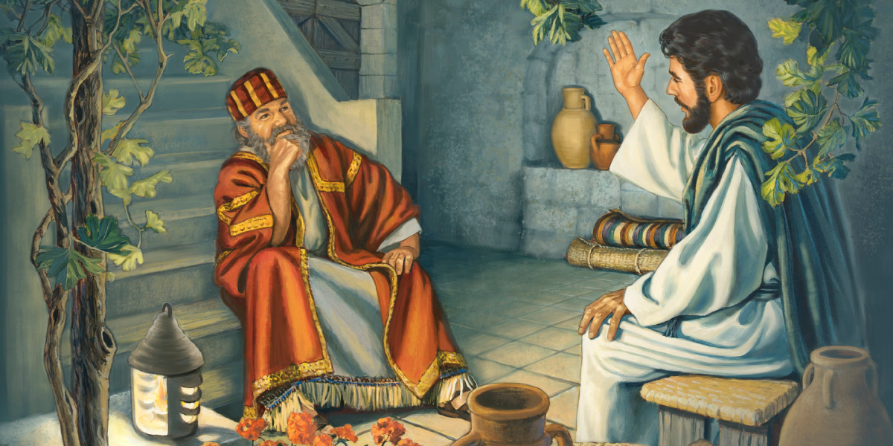
Chapters 1–3: The Beginning of Jesus’ Ministry
John 1: Jesus is the Word (Logos) made flesh; John the Baptist testifies about Him.
John 2: Jesus turns water into wine and cleanses the temple.
John 3: Jesus teaches Nicodemus about being born again and introduces John 3:16.

Slide 34
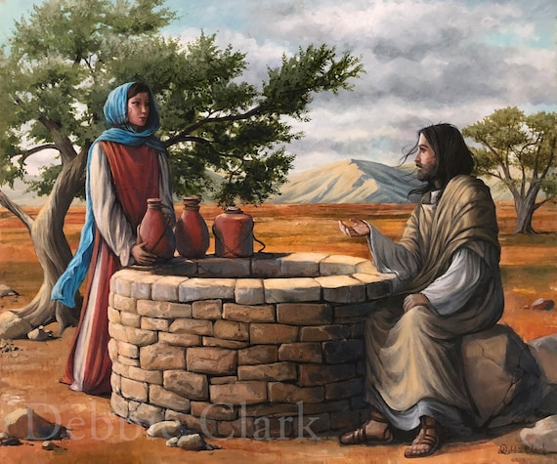
Chapters 4–6:
Chapters 4–6: The Living Water and Bread of Life
John 4: Jesus meets the Samaritan woman and offers her living water.
John 5: Jesus heals a paralyzed man and teaches about His authority as the Son of God.
John 6: Jesus feeds the 5,000 and declares, “I am the Bread of Life.”

Slide 35
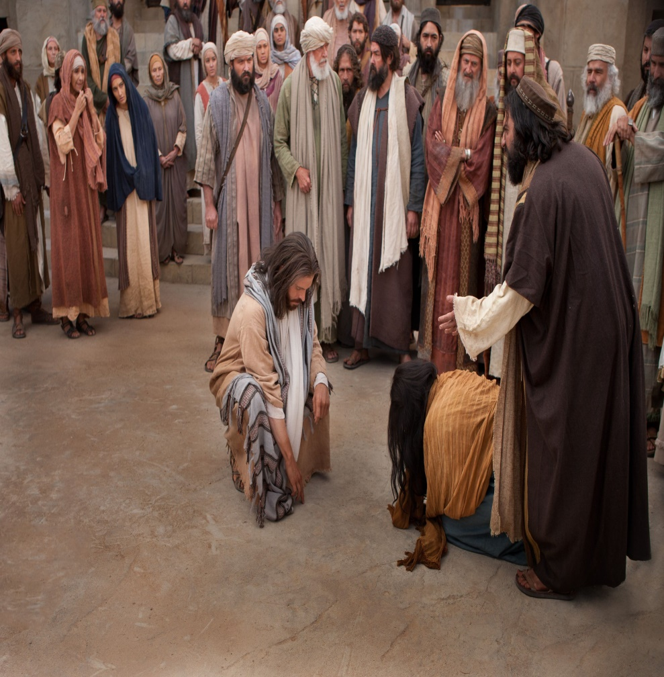
Chapters 7–9:
Chapters 7–9: Jesus as the Light of the World
John 7: Jesus teaches at the Feast of Tabernacles, causing division among the people.
John 8: Jesus forgives the woman caught in adultery and declares, “I am the Light of the World.”
John 9: Jesus heals a blind man, exposing the Pharisees’ spiritual blindness.

Slide 36
Chapters 10–12: The Good Shepherd and the Coming Glory
John 10: Jesus describes Himself as the Good Shepherd who lays down His life.
John 11: Jesus raises Lazarus from the dead, proving His power over death.
John 12: Jesus enters Jerusalem as a king, but He speaks about His upcoming death.

Slide 37
Chapters 13–15: Love, Service, and the Vine
John 13: Jesus washes the disciples' feet and predicts His betrayal.
John 14: Jesus comforts His disciples, saying, “I am the Way, the Truth, and the Life.”
John 15: Jesus teaches about abiding in Him as the True Vine.
Notes:
Key Message: Jesus calls His followers to love, serve, and stay connected to Him.

Slide 38
Chapters 16–18
Chapters 16–18: The Holy Spirit, Prayer, and Betrayal
John 16: Jesus promises the Holy Spirit to guide His followers.
John 17: Jesus prays for His disciples and all believers.
John 18: Jesus is arrested and put on trial.
Notes:
Key Message: Jesus prepares His disciples for the future, giving them peace and purpose.

Slide 39
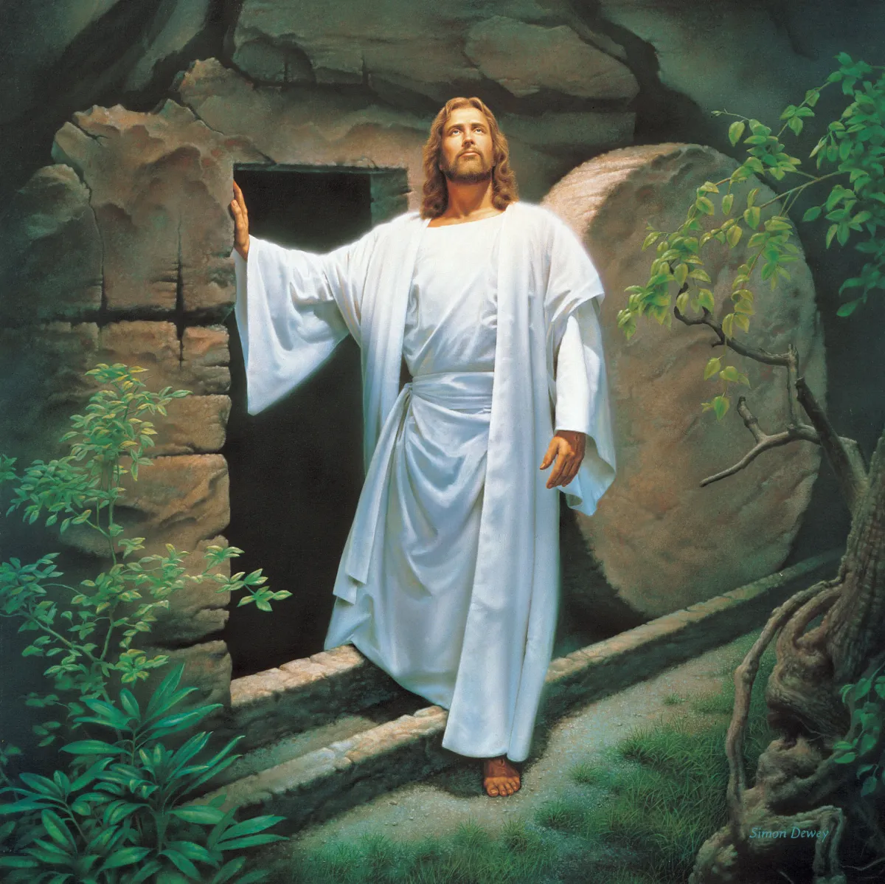
Chapters 19–21: Death, Resurrection, and Restoration
John 19: Jesus is crucified and buried.
John 20: Jesus rises from the dead and appears to His disciples.
John 21: Jesus restores Peter and commissions His followers.
Notes:
Key Message: Jesus’ death and resurrection bring forgiveness, restoration, and mission.

Slide 40
Conclusion
The Gospel of John presents Jesus as the Son of God who offers eternal life.
John’s purpose is to lead people to faith in Jesus.
Believers are called to follow, abide in Him, and share His message.
Notes:
This conclution brings us to the end of our presentation

Slide 41
Thanks!

